Slide 1
Project Unicorn
Doug Herd – SE Candidate

Slide 2

Project Unicorn
Doug Herd – SE Candidate

Slide 3
Project Requirements
Demonstrate your understanding, proficiency and creativity by using any cloud based service (Pivotal Web Services, Heroku, Aerobatic, AWS, Azure, Google, etc...) and the code language of your choice, complete the following project: Create an API endpoint that presents your resume as a JSON object. You are free to take this in any direction beyond the raw JSON object.
Once you have created this API endpoint send me a link to the GitHub repo where your code is. The repo should include enabling code, the URL, and resulting resume in JSON format. In addition, include a presentation describing what you did and the approach you took. When complete, we will schedule a time for you to deliver a 20 minute presentation to a panel.
Please have this completed in 7 days.

Slide 4
Plan Of Attack
AWS API Gateway
Largest cloud provider
Full product suite
Lots of documentation for support
Lots of potential for post project learning
JSON Resume
Lots of customization
Arrays vs. Objects, how to display them
S3 Bucket for content
Easy integration to AWS stack / AWS API
GitHub
Standard for code drop / project requirement

Slide 5
Steps
Learn JSON
Google / YouTube / w3Schools Online / JSONLint
Write Resume in JSON
Checking Code on JSONLint to ensure Valid JSON
Decide on cloud API platform
AWS – Biggest Cloud Provider in the Industry
Utilize S3 Bucket for content storage
Testing / Making Changes
Modifying Objects / Testing different layouts
Send up to GitHub

Slide 6
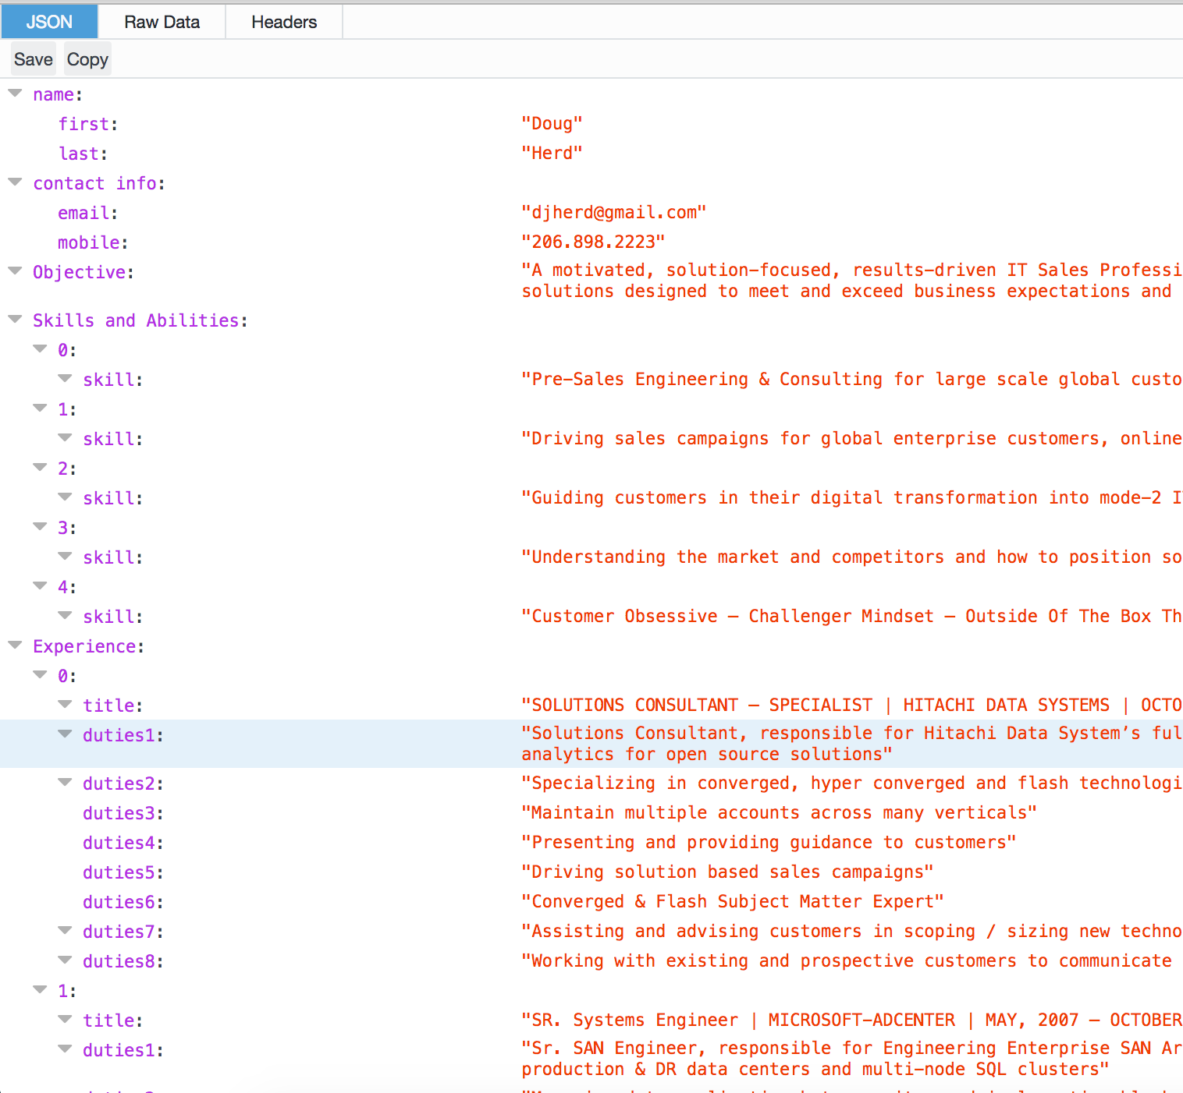
Solution Outline
Client Request
Client Response
AWS API GW URL
“JSON RESUME AWS API
Method Request
GET Method to ARN
Integration Request
Specifies HTTP:// for content
Passes to Specified S3 Bucket
Method Response
Specifies JSON Format
S3 Bucket
Contains Resume in
{JSON Format}
Integration Response
Passes through HTTP:// to Method Response

Slide 7
Issues Along The Way
Invalid JSON
Utilized “Brackets”, a free tool for MAC to store and edit JSON / HTML files.
Utilized JSONLint.com to validate JSON syntax and get tips if it was invalid.
Navigating the AWS API Gateway
To use Lambda or to not use Lambda
Where do store the JSON file (http:// Repository)
Attempted to use OneDrive / Decided on S3
Security Issues on S3 Bucket after Deploying API
ACL set to READ for Public
Quick Google Search provided the necessary Security script to add to the Bucket Policy

Slide 8
What I learned
Coding is hard
until you figure it out
JSON is powerful if you know how to utilize it
Bigger data sets can show possible trends
Digging into AWS offerings is interesting – moving forward….
Route 53 Options
More potential using Lambda
Pull from outside feeds – NFL Stats / Weather / etc..
Alexa Open API’s
Log to console
Fun way to challenge and learn
Out of my comfort zone
Challenging
Interesting

Slide 9
Thank you

Slide 10
Thank you
Doug Herd – SE Candidate

